Slide 1
Introduction to
Using ChatGPT to write Python code
Hamilton Python Users Group
Ian Stewart
13 February 2023

Slide 2
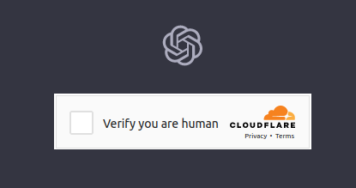
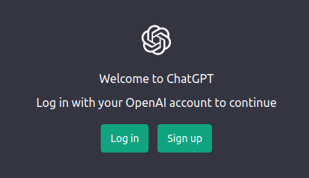
What is ChatGPT?
Chat Generative Pre-trained Transformer = “chatbot”
Chatbot = a software application used to conduct an online chat conversation via text or text-to-speech, in lieu of providing direct contact with a live human agent.
Launched by OpenAI in November 2022
OpenAI website: https://openai.com/
OpenAI ChatGPT website: https://chat.openai.com/chat
Play ground: https://platform.openai.com/playground

Slide 3
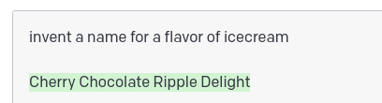
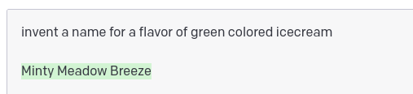
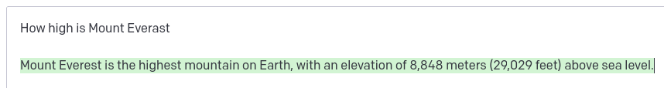
ChatGPT Playground
https://platform.openai.com/playground

Slide 4
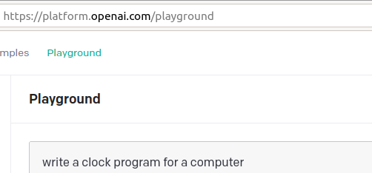
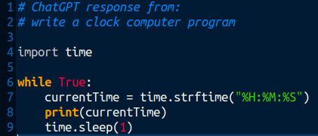

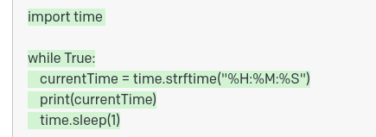
Playground – Clock program 1st time - Python
$ python clock.py
18:38:47
18:38:48
18:38:49
18:38:50

Slide 5
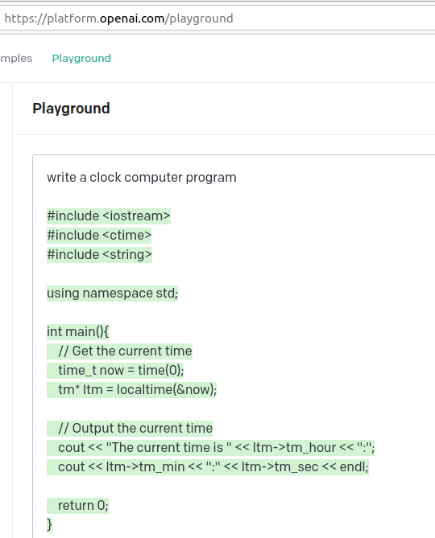
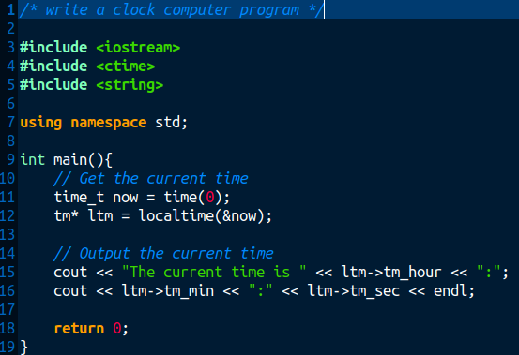
Playground - Clock program 2nd time - C++
Not: write a clock program for a computer
$ g++ clock.cpp -o clock
$ ./clock
The current time is 18:30:36
$ ./clock
The current time is 18:30:39

Slide 6
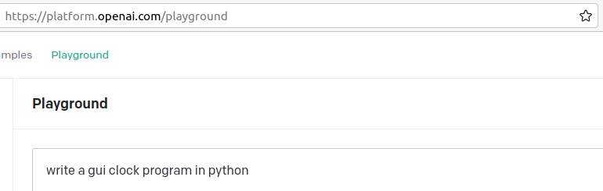
Playground – Requesting Python and GUI

Slide 7
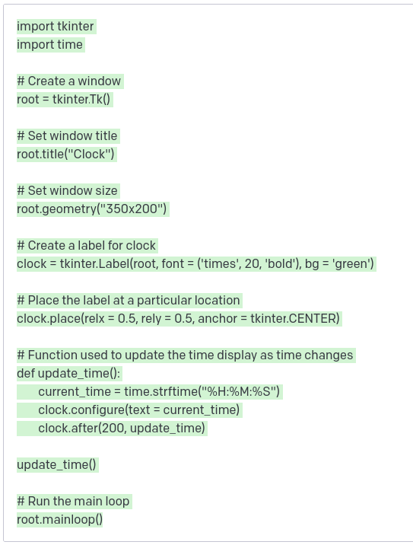
Playground – Python code with Tkinter GUI

Slide 8
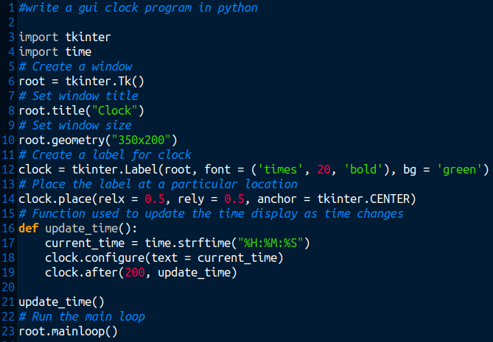
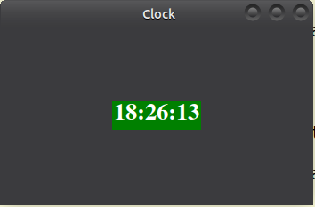
Playground – Python code with Tkinter GUI

Slide 9
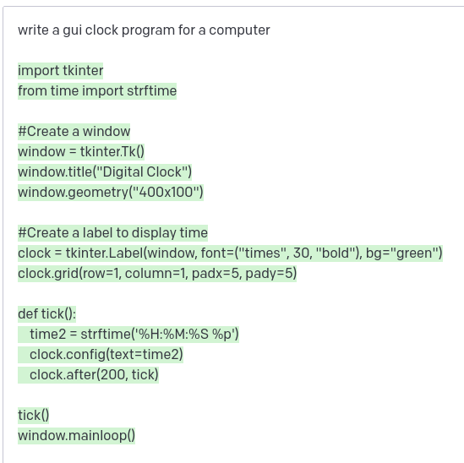
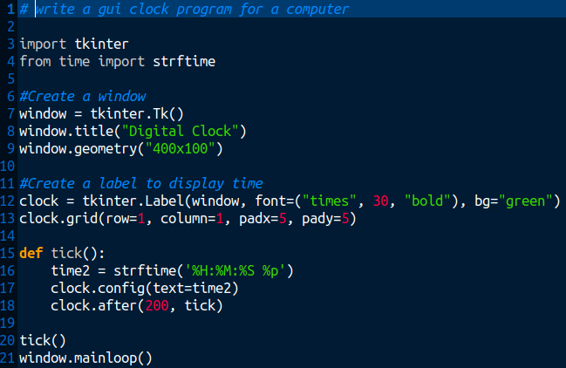
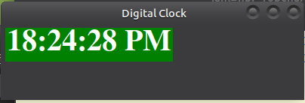
Playground – Slight variation – Still Python/Tkinter
Not: write a gui clock program in python

Slide 10
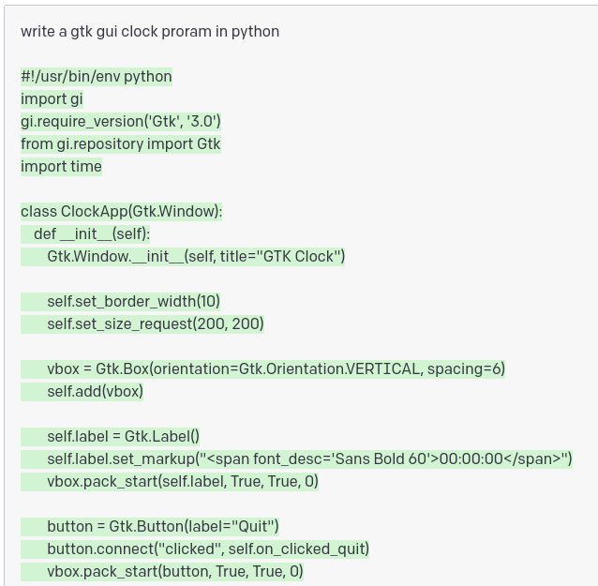
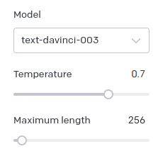
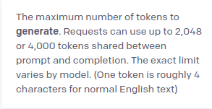
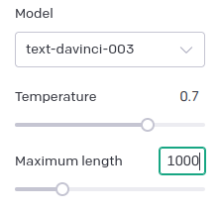
Gtk Clock – Truncated output.
Increase Maximum length
Stops! Huh?

Slide 11
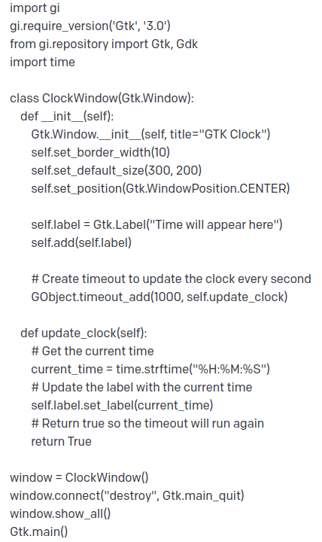
Gtk Clock. With increased “Maximum Length”
Was Truncated

Slide 12
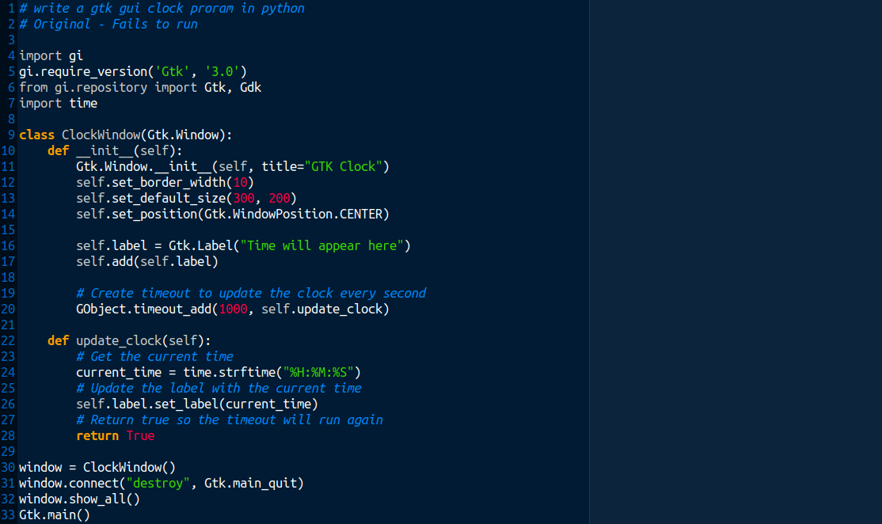
Gtk Clock – Issues with the code
Gtk now at version 4, but version 3 still supported
No Gobject, but deprecated need GLib. Gdk not used
Deprecated. Use: label=”Time will appear here”
Deprecated. Use Glib not GObject

Slide 13
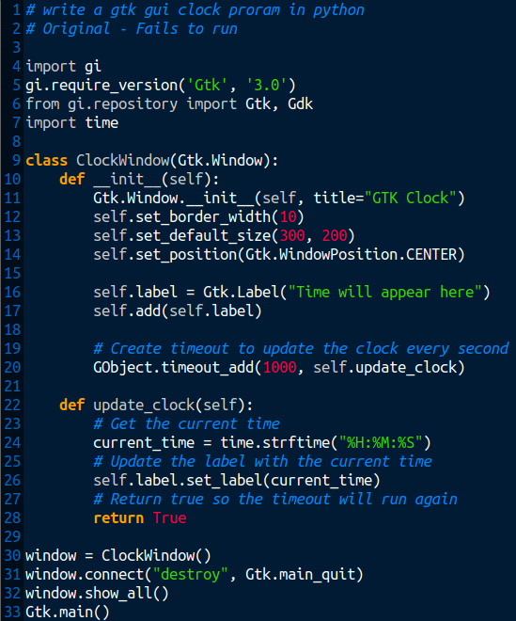
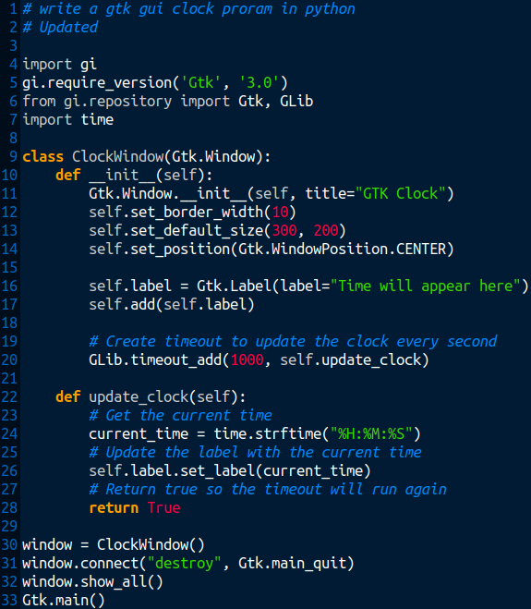
Before and After

Slide 14
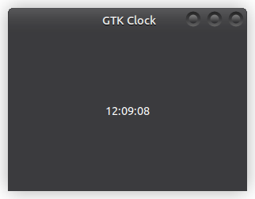
Running the updated Gtk clock
$ python clock_gtk.py

Slide 15
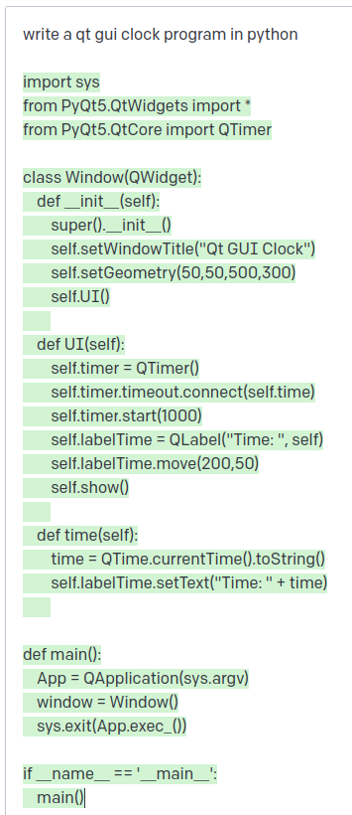
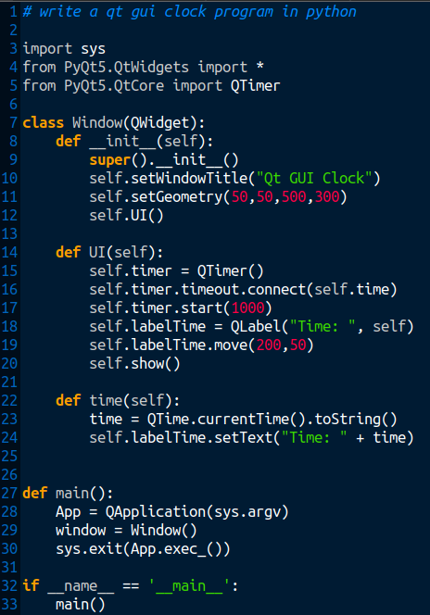
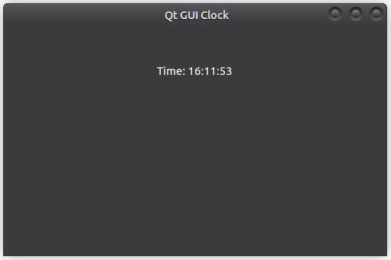
Qt GUI Clock
Preference: List the Widgets
Add: , QTime
Increase size of string:
("Time: ", self)
QTime

Slide 16
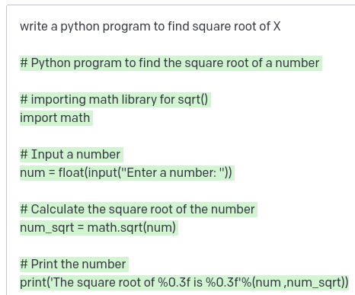
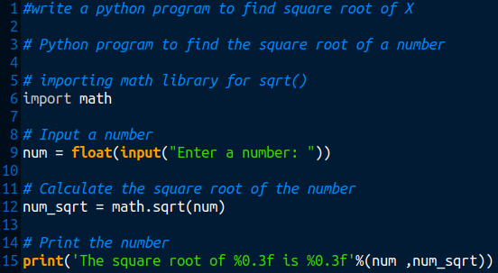
Square root of x
0
$ python square_root.py
Enter a number: 98.01
The square root of 98.010 is 9.900
$ python square_root.py
Enter a number: 169
The square root of 169.000 is 13.000

Slide 17
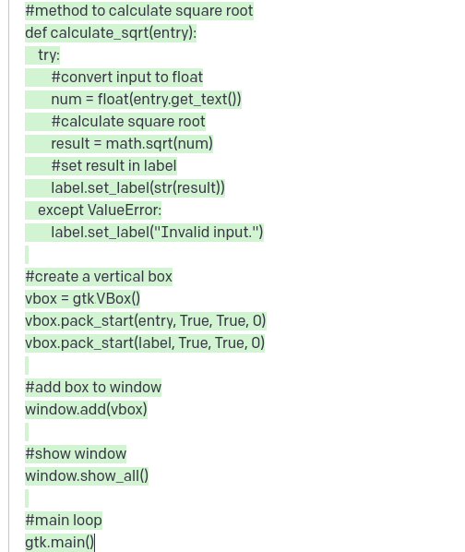
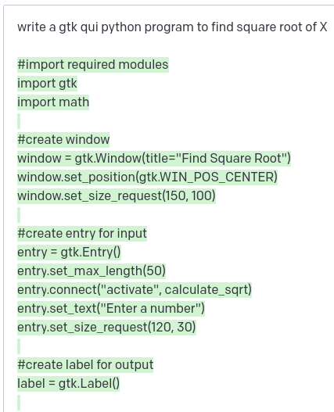
Gtk GUI Square root of x
Position function above call
from gi.repository import Gtk
Change all gtk. to Gtk.
Obsolete
Call before function defined

Slide 18
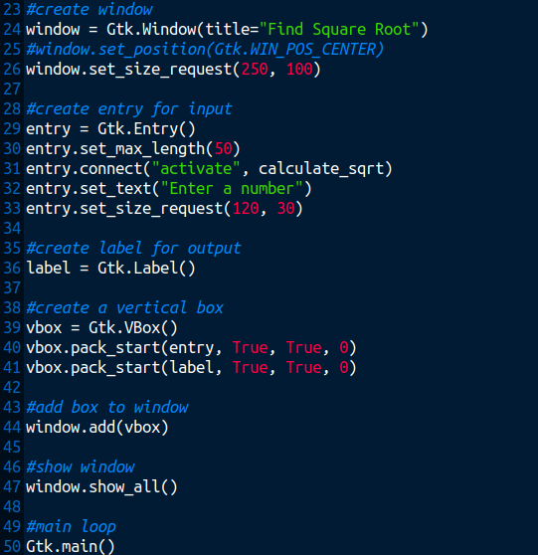
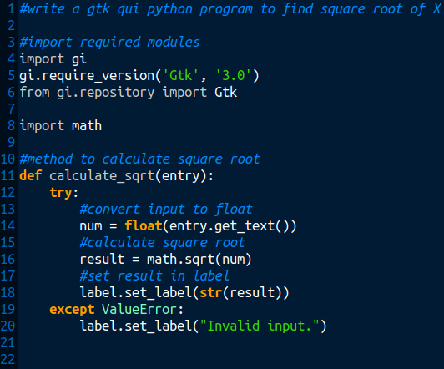
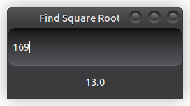
Gtk GUI Square root of x

Slide 19
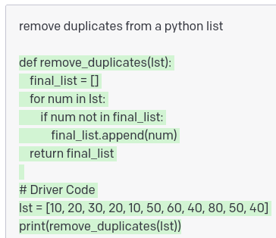
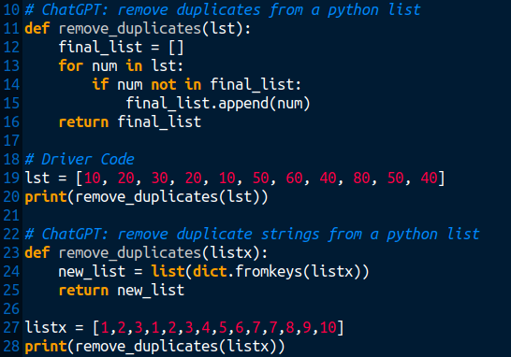
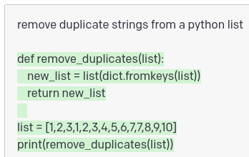
Remove duplicates from a list
$ python remove_duplicates.py
[10, 20, 30, 50, 60, 40, 80]
[1, 2, 3, 4, 5, 6, 7, 8, 9, 10]

Slide 20
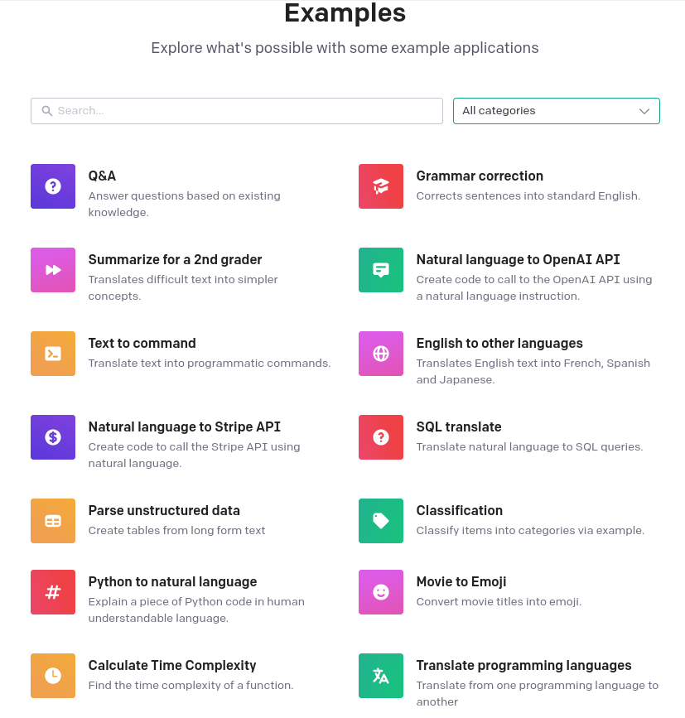







Example Applications: https://platform.openai.com/examples

Slide 21
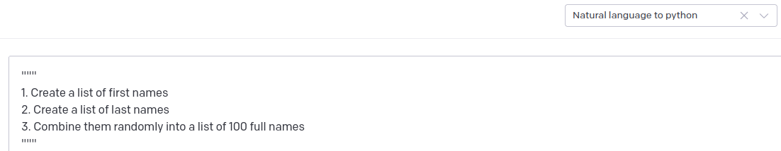
Natural Language to Python Application – random_names.py
Load preset

Slide 22
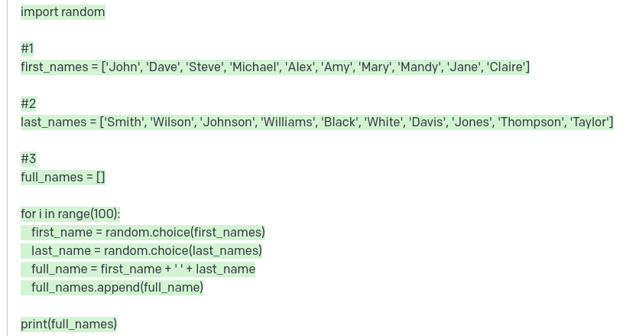
Natural Language to Python Application – random_names.py

Slide 23
Natural Language to Python Application – random_names.py

Slide 24
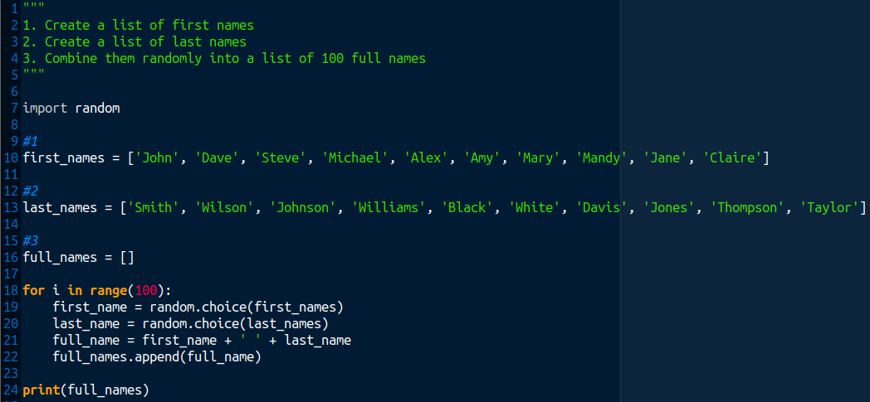
Natural Language to Python Application – random_names.py

Slide 25
Natural Language to Python Application – random_names.py
$ python random_names.py
['Jane Johnson', 'Claire Jones', 'Mandy Thompson', 'Claire Williams', 'John Smith', 'Claire Williams', 'Dave Williams', 'John Thompson', 'Claire Taylor', 'Steve Johnson', 'Michael Black', 'Mandy Smith', 'Dave Black', 'Mandy Davis', 'Amy White', 'Steve Black', 'Jane Black', 'Steve White', 'Jane Davis', 'Dave Smith', 'Alex Jones', 'Steve Smith', 'Mandy Davis', 'John Johnson', 'Michael Taylor', 'Dave Williams', 'Mary Smith', 'Jane Jones', 'Dave Johnson', 'Dave Wilson', 'Amy Taylor', 'Alex Johnson', 'Jane White', 'Mary Wilson', 'Dave Williams', 'Michael Jones', 'Mandy Johnson', 'Michael Taylor', 'Amy Williams', 'Alex Wilson', 'John Smith', 'Steve Taylor', 'John White', 'Dave Johnson', 'John Wilson', 'Mary White', 'Alex Davis', 'Jane White', 'Dave Davis', 'Dave Wilson', 'Alex Taylor', 'John Black', 'Amy Johnson', 'Claire Johnson', 'Mary Johnson', 'Mary Taylor', 'Alex Jones', 'Michael Jones', 'Alex Johnson', 'Claire Wilson', 'Alex Davis', 'Mary Thompson', 'Jane Black', 'Michael White', 'Jane Thompson', 'Jane Taylor', 'Jane Johnson', 'Alex Williams', 'John Williams', 'Steve Johnson', 'Claire Thompson', 'Alex Davis', 'Jane Thompson', 'Jane White', 'Mary Johnson', 'John Thompson', 'Alex Black', 'Michael Black', 'Alex Black', 'Claire Davis', 'Mandy Smith', 'Steve Williams', 'John Jones', 'Amy Johnson', 'John Taylor', 'Dave Taylor', 'Mary White', 'Jane White', 'Claire Black', 'Amy Thompson', 'Amy Smith', 'Steve Smith', 'Alex Davis', 'Dave Wilson', 'Jane Black', 'Amy Johnson', 'John Wilson', 'John Thompson', 'Dave Jones', 'Amy Smith']

Slide 26
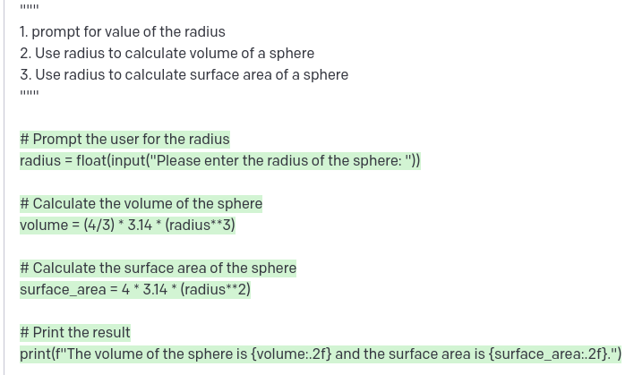
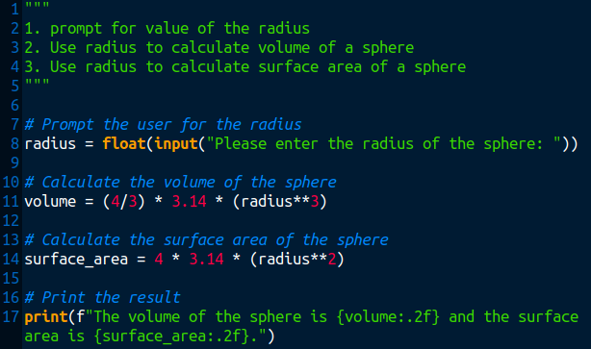
Natural Language to Python Application – sphere.py
$ python sphere.py
Please enter the radius of the sphere: 10
The volume of the sphere is 4186.67 and the surface area is 1256.00.

Slide 27
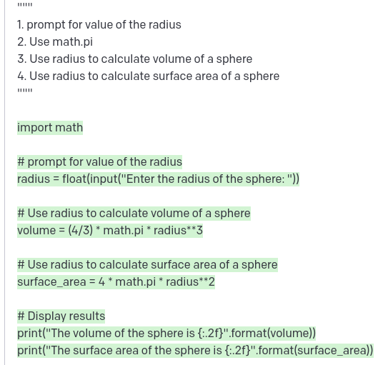
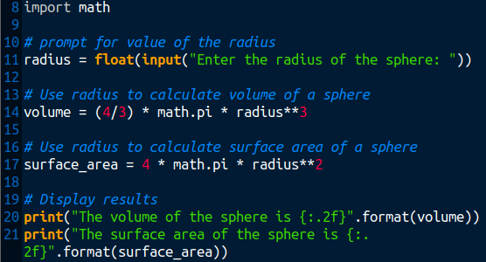
Natural Language to Python Application – sphere_v2.py
Use math.pi, not 3.14
$ python sphere_v2.py
Enter the radius of the sphere: 10
The volume of the sphere is 4188.79
The surface area of the sphere is 1256.64

Slide 28
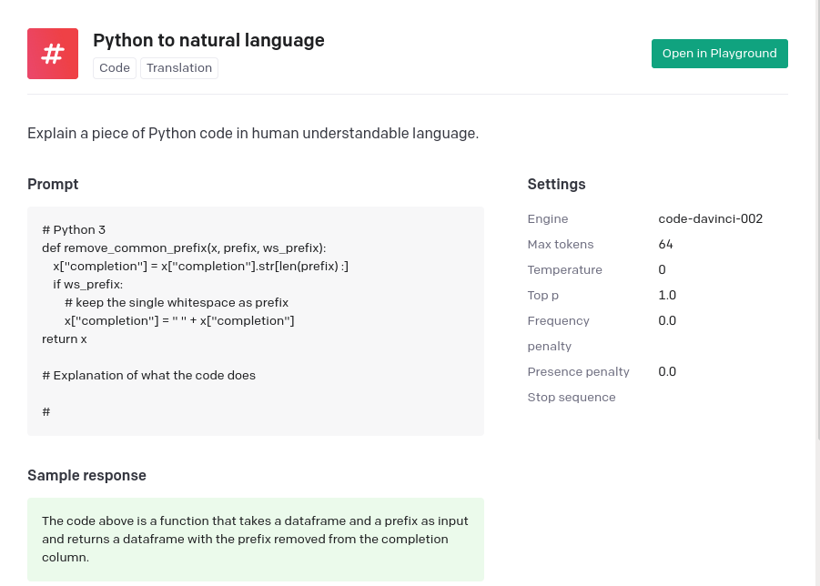
Python to Natural Language Application

Slide 29
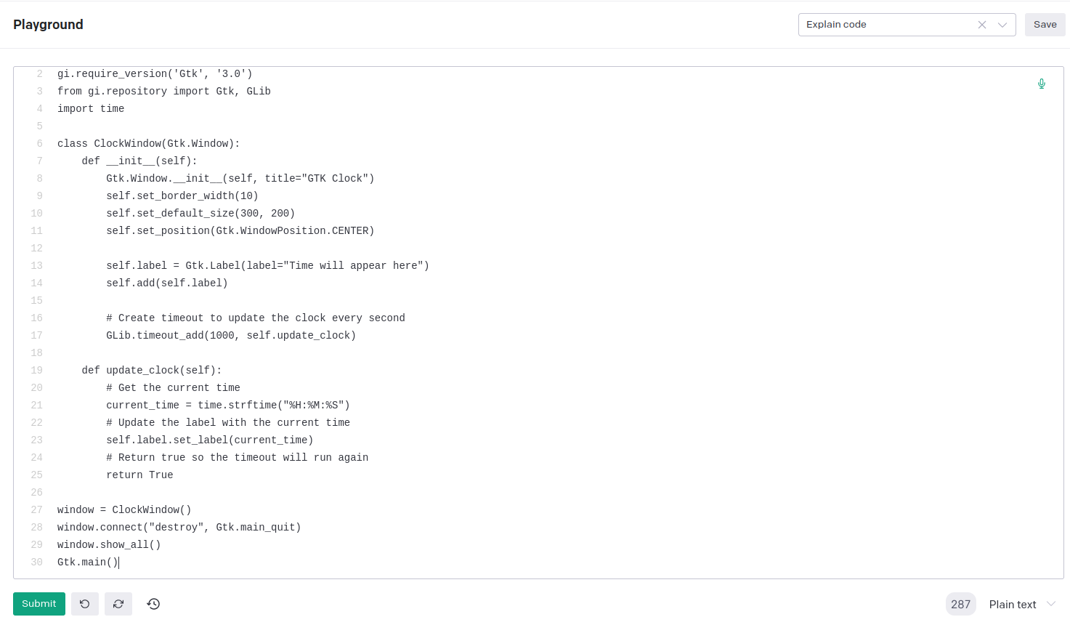
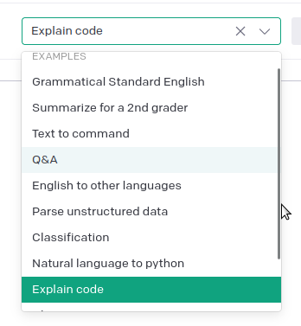
Python to Natural Language Application
Load preset

Slide 30
Python to Natural Language Application
"""
Here's what the above class is doing:
1. The __init__ method creates a label and adds it to the window.
2. The update_clock method gets the current time and updates the label.
3. The timeout is created with a call to GLib.timeout_add. The first argument is the number of milliseconds to wait before calling the function. The second argument is the function to call.
4. The update_clock method returns True so that the timeout will run again.
Paste this at the end of the python code…
"""
Here's what the above class is doing:
1.
Increase:
Maximum length

Slide 31





Controls: Model / Temperature / Length.

Slide 32


Stopwatch Examples – Using “Chat”
$ python stopwatch.py
Elapsed Time: 0.00s
Press "q" to quit: #<--- Pressed Return key
Elapsed Time: 1.43s
Press "q" to quit:
Elapsed Time: 3.53s
Press "q" to quit: q

Slide 33


Stopwatch Examples – Using “Natural Language to python”
1. Create a stopwatch class.
2. In the class provide the methods: start and stop.
3. provide a menu to select start and stop comands to call class
4. Display elapsed time.

Slide 34
Stopwatch Examples –
Using “Natural Language to python”
$ python stopwatch_class.py
What would you like to do?
1. Start Timer
2. Stop Timer
3. Quit
Please enter your choice: 1
What would you like to do?
1. Start Timer
2. Stop Timer
3. Quit
Please enter your choice: 2
Elapsed time: 4.27
What would you like to do?
1. Start Timer
2. Stop Timer
3. Quit
Please enter your choice: 3
Goodbye!

Slide 35
Stopwatch Examples – Using “Explain code” – Temperature 0.0
Here's what the above class is doing:
1. The start method records the current time.
2. The stop method records the current time and then calculates the elapsed time.
3. The elapsed time is stored in the elapsed_time attribute.
4. The elapsed time is rounded to two decimal places.
1. Create a stopwatch class.
2. In the class provide the methods: start and stop.
3. provide a menu to select start and stop comands to call class
4. Display elapsed time.

Slide 36
Stopwatch Examples – Using “Explain code” – Temperature 0.7
Here's what the above class is doing:
1. The Stopwatch class defines the start, stop and elapsed time methods.
2. In the main function, an instance of the Stopwatch class is made.
3. In the main function, a while loop is created to run the main function.
The while loop is set to run until the user enters in a value of 3.
4. The menu function is called in the main function.
This function creates a menu and prompts the user to enter in a value.
5. The user's input is saved to a variable called choice.
6. An if statement is created to test the value of choice.
If choice is equal to 1, then the start method from the Stopwatch class is called.
7. An elif statement is created to test the value of choice.
If choice is equal to 2, then the stop method from the Stopwatch class is called.
Then, the elapsed time method from the Stopwatch class is called and saved to the elapsed_time variable.
The elapsed time is printed to the screen.
8. An elif statement is created to test the value of choice.
If choice is equal to 3, then a message is printed to the screen.
9. An else statement is created to test the value of choice.
If choice is not equal to 1, 2, or 3, then a message is printed to the screen.
1. Create a stopwatch class.
2. In the class provide the methods: start and stop.
3. provide a menu to select start and stop comands to call class
4. Display elapsed time.

Slide 37



WebServer – Using “Natural language to Python” – Temperature 0.7
1. Create a webserver engine
2. Add a webpage that is green
Suggestion: Add at start of python code...
print("View Webpage on a browser: http://localhost:8080/")

Slide 38

WebServer – Using “Natural language to Python” – Temperature 0.7
1. Create a HTTP webserver engine
2. Add a webpage.
3. Add to the webpage a form
4. The form has: first_name, surname, age fields
5. The form has a submit button
Suggestion: Add at start of python code...
print("View Webpage on a browser: http://localhost:8000/")

Slide 39



WebServer – Using “Natural language to Python” – Temperature 0.7
$ python webserver_v2.py
View Webpage on a browser: http://localhost:8000/
127.0.0.1 - - [10/Feb/2023 18:33:04] "GET / HTTP/1.1" 200 -

Slide 40


WebServer Stopwatch – Using “Natural language to Python” – T =0.7
1. Create a HTTP webserver engine.
2. Add a stopwatch webpage.
3. Add to the webpage a start and stop button.
4. Display elapsed time.
Suggestion: Add at start of python code...
print("View Webpage on a browser: http://localhost:8000/")

Slide 41



WebServer Stopwatch
Suggestion: Add at start of python code...
print("View Webpage on a browser: http://localhost:8000/")

Slide 42
ChatGPT Account
When applying for a ChatGPT account at https://chat.openai.com/chat:
Initial requirements are to provide:
Email address - (which is verified)
Mobile phone number - (which is sent a token/pin)

Slide 43



Pricing

Slide 44

Account

Slide 45
Demo: ChatGPT to write Python code
Log into: https://chat.openai.com/chat
Use Playground: https://platform.openai.com/playground
Load Preset: “Chat”, “Natural Language to Python”, or “Explain Code”

